Slide 1
Light and Lenses:
How Do Your Eyes Help You See?

Slide 2
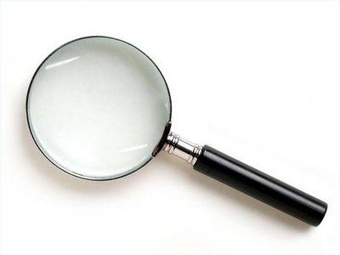
What is a lens?
A lens is a curved surface, like a piece of glass or plastic.
Its curved shape makes light bend.
Lenses can make objects appear bigger or smaller to our eyes.

Slide 3
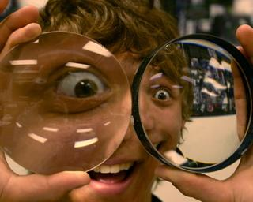

Slide 4
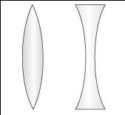
We just observed two types of lenses. Who knows what these two lenses are called?

Slide 5
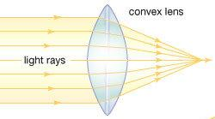
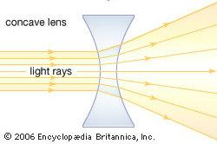
...Convex and Concave Lenses!
Convex Lenses
curve outward
make light converge
make images appear bigger
Concave Lenses
curve inward
make light spread out
make images appear smaller
Notes:
Light bends because of the shape of the glass and because light cannot travel as quickly through solid as it can travel through gas.
It should be noted that while light appears to bend, the rays do not bend but rather are refracted-- like we saw in the experiments with water.

Slide 6
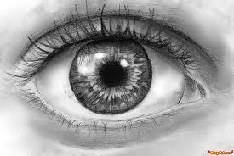
So what does this all have to do with our eyes?

Slide 7
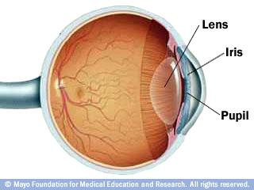
Our eyes have lenses that help us to see the world around us!

Slide 8
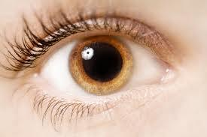
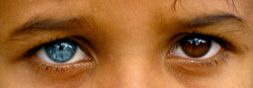
Light enters our eyes through our pupils, the black dot in the middle of our eyes. The pupil is protected by a transparent layer called the cornea.
The colored part around the pupil is called the iris. It controls how much light gets into our eyes. The light then travels through the lens, which focuses the image of the object. The ciliary muscle changes the shape of the lens to help it focus.
Light focused through the lens goes to a layer of tissue in the back of the eye called the retina. The signals collected there are sent to the optic nerve, which transmits the image to the brain.

Slide 9
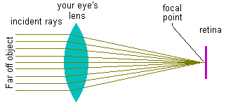
Here is a model of the lens in your eye:

Slide 10
What type of lens is in your eye?
a) Prism
b) Convex Lens
c) Mirror
d) Concave Lens
Notes:
Convex Lens

Slide 11
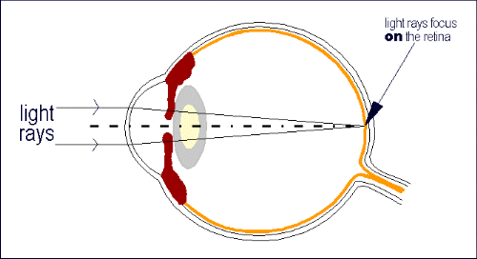
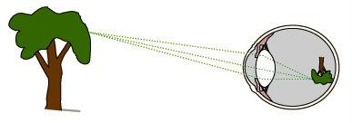
The convex lens focuses light rays onto the retina, which has cells that detect light.
The image projected in our eye is actually upside down!
The brain flips the image back to its original state.

Slide 12
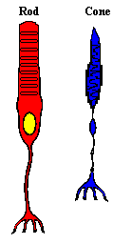
Two Types of Light Receptors
Cones help us see colors of objects. There are 3 types of cones and each one helps us see a different color: red, blue, and green.
Rods allow the eye to see shapes and sizes of objects in grey, black, and white.

Slide 13
Let's Review!
Lenses make objects appear bigger or smaller.
The lens in our eye is a convex lens.
Many parts of our eye manipulate the path of light to help us see images.
The iris controls how much light enters the eye,
the ciliary muscle controls the shape of the lens,
and the optic nerve transmits images to the brain.

